Slide 1
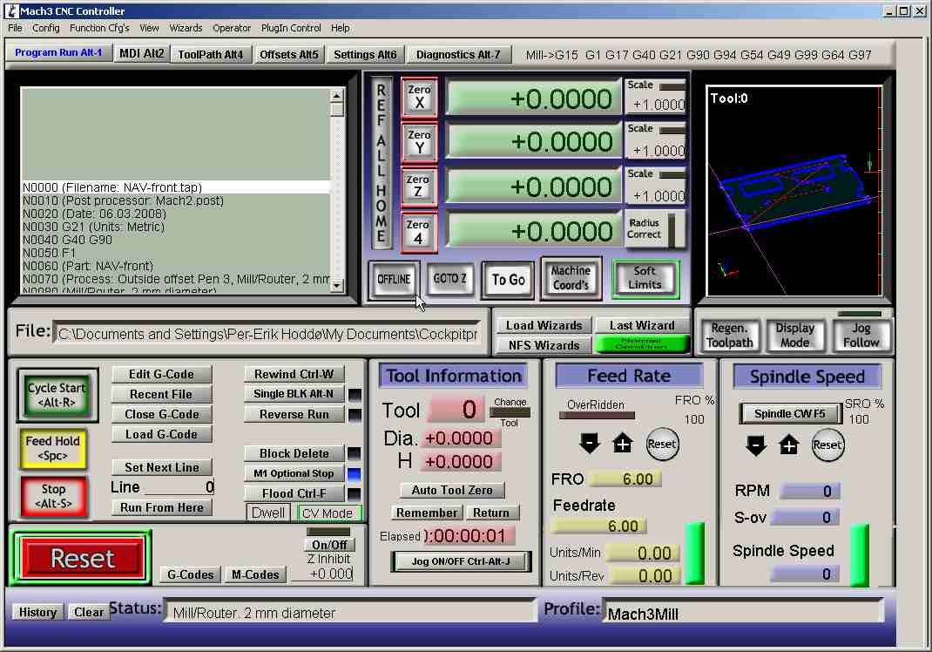
Notes:
Designing for people
It has color
It has a lot of information all in one place
There is a decent amount of eye movement
Designing for Usage
For a machinist, this UI is great
Has all of the information all in one place
Designing for Workflow
Most common things are front in center (ie. Reset)
Everything is clearly labeled
Has lots of help (although usually not needed)
Consistant

Slide 2
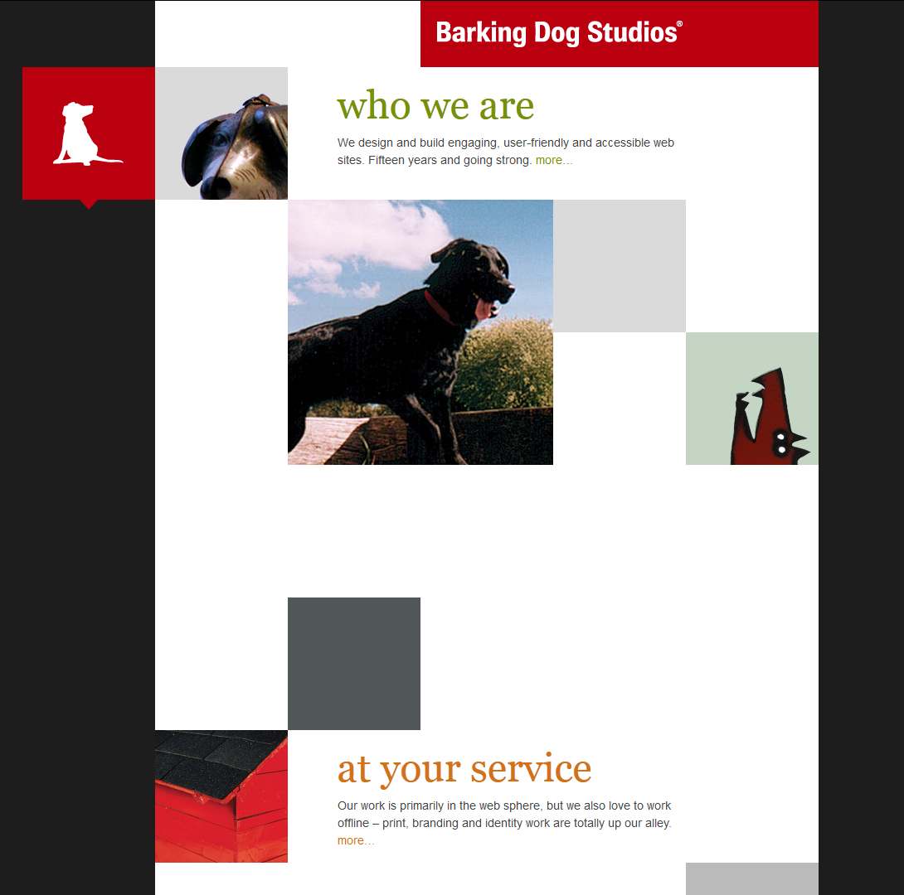
Notes:
Designing for people
Nice colors and contrast
Images can attract interest
Very eye catching
Does not assume that people read
Assuming you only scroll down, the UI makes sense
UI is designed to be used by a mouse which makes sense for their customer base
Designing for Usage
The website is not logical or straightforward
Assuming the user only scrolls down, the workflow works
Designing for Workflow
User, without prior knowledge, will have no idea how to traverse the website
No help documentation if the user gets stuck
Buttons are not labeled or intuitive

